Slide 1
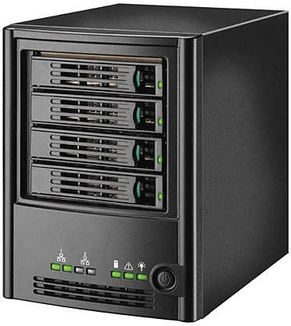

microsamples
microsamples
energy models
energy models
microsamples
energy models
microsamples
energy models

Slide 2
Captures System Dynamics?
No
Yes
ML
CALOREE
Handles Non-Linearities?
No
Yes
Not Useful
Control

Slide 3
Model 1
Model 2
Model N
Model
…
…
App
1
App
2
App
N
App
1
App
2
App
N
Mean,
Variance
Model 1
Model 2
Model N
…
App
1
App
2
App
N

Slide 4
Model
Model 1
Model 2
Model N
…
…
App
1
App
2
App
N
App 1
App 2
App N
Model
Mean,
Variance
…
Model 1
Model 2
Model N
App 1
App 2
App N
…
App
1
App
2
App
N

Slide 5
Application
-
Control
System
Performance
Requirement
big cores
big speeds
LITTLE cores
LITTLE speeds
Performance Feedback

Slide 6
0
0.1
0.2
0.3
Configuration Array
0.4
Speedup Index
c = 0
sc = 0
pc = .01
c = 1
sc = .2
pc = .08
c = 2
sc = .8
pc = .6
c = 3
sc = 1
pc = 1
0.5
0.6
0.7
0.8
0.9
1

Slide 7
Server: Running HBM
Model
Performance/Power Samples
…
Performance
Hash Table
+ Model Variance
App 1
App 2
App N
Embedded/Mobile Device: Running Generalized Control System
Application
Performance
Requirement
Control
System
App-specific
Optimizer
big cores
big speeds
-
LITTLE cores
LITTLE speeds
Performance Feedback

Slide 8
Server, Running HBM
…
App 1
App 2
App N
App N
App N
Performance
Requirement
Performance Hash Table
-
Light-weight Control
System
App-specific
Optimizer
big cores
big speeds
LITTLE cores
LITTLE speeds
Performance Feedback

Slide 9
Performance
Hash Table
+
Control tuning parameter
Embedded/Mobile Device: Running Generalized Control System
Resources
Server: Running transfer learning algorithms
Model
Performance
Requirement
Control
System
App-specific
Optimizer
big cores
big speeds
-
…
Performance Feedback
LITTLE cores
LITTLE speeds
App 1
App 2
App N
Machine learning model fits here
Performance/Power Samples
t = t₂
Timeline
t = 0
t = t₁
1. An application starts:
The controller begins with a generic model.
2. Queries server for how many samples are required
Controller can now use the machine learning model and its tuning parameter

Slide 10
Server: Running different transfer learning algorithms
Performance
Hash Table
+
Control tuning parameter
Embedded/Mobile Device: Running Generalized Control System
Resources
Performance
Requirement
Control
System
App-specific
Optimizer
big cores
big speeds
-
Performance Feedback
LITTLE cores
LITTLE speeds
Machine learning model fits here
t = t₂
Timeline
t = 0
t = t₁
2. Queries server for how many samples are required
3. The device sends required samples to the learner which asynchronously assembles a model
The server returns a model customized for the application
1. An application starts:
The controller begins with a generic model until it receives a better model.
Performance/Power Samples

Slide 11
Performance/Power Samples
Performance
Hash Table
+
Control tuning parameter
Server: Running different transfer learning algorithms
Collecting Samples Model estimation
Learner sleeps or supports other apps
Timeline
Generic control model Learned Control Model
An application starts: The controller begins with a generic model until it receives a better model.
Queries server for how many samples are required
The device sends required samples to the learner which asynchronously assembles a model
The server returns a model customized for the application
t = t₀ t = t₁ t = t₂ t = t₁

Slide 12

Server: Running
transfer learning algorithms
Machine learning model as Performance Hash Table
+
Tuning parameter(pole) for controller
i
1
2
o
j
k
3
p
4
Embedded/Mobile Device: Running Generalized Control System
Resources
Performance
Requirement
big cores
big speeds
-
Control
System
App-specific
Optimizer
LITTLE cores
LITTLE speeds
Performance Feedback

Slide 13
Collecting
Samples
Model
Estimation
Learner sleeps or supports other apps
Control Learning
1
2
3
4
Generic control model
Learned Control Model
Timeline
1
An application starts: the controller begins with a generic model and
queries the learner for the number of samples to take
2
The learner responds with the number of samples needed, the controller continues
3
The controller sends its samples back to the learner which asynchronously assembles a model
4
The learner responds with a model customized for the application

Slide 14
Server: Running
transfer learning algorithms
Machine learning model as Performance Hash Table
+
Tuning parameter(pole) for controller
i
1
2
o
j
k
3
p
4
Embedded/Mobile Device: Running Generalized Control System
Resources
Performance
Requirement
big cores
big speeds
-
Control
System
App-specific
Optimizer
LITTLE cores
LITTLE speeds
Performance Feedback

Slide 15
Server: Running
transfer learning algorithms
Machine learning model as Performance Hash Table
+
Tuning parameter (pole) for controller
i
1
2
o
j
k
3
p
4
Embedded/Mobile Device: Running Generalized Control System
Resources
Performance
Requirement
big cores
big speeds
-
Control
System
App-specific
Optimizer
LITTLE cores
LITTLE speeds
Performance Feedback
Collecting
Samples
Model
Estimation
Learner sleeps or supports other apps
Control Learning
1
2
3
4
Generic control model
Learned Control Model
Timeline
1
An application starts: the controller begins with a generic model and
queries the learner for the number of samples to take
2
The learner responds with the number of samples needed, the controller continues
3
The controller sends its samples back to the learner which asynchronously assembles a model
4
The learner responds with a model customized for the application

Slide 16
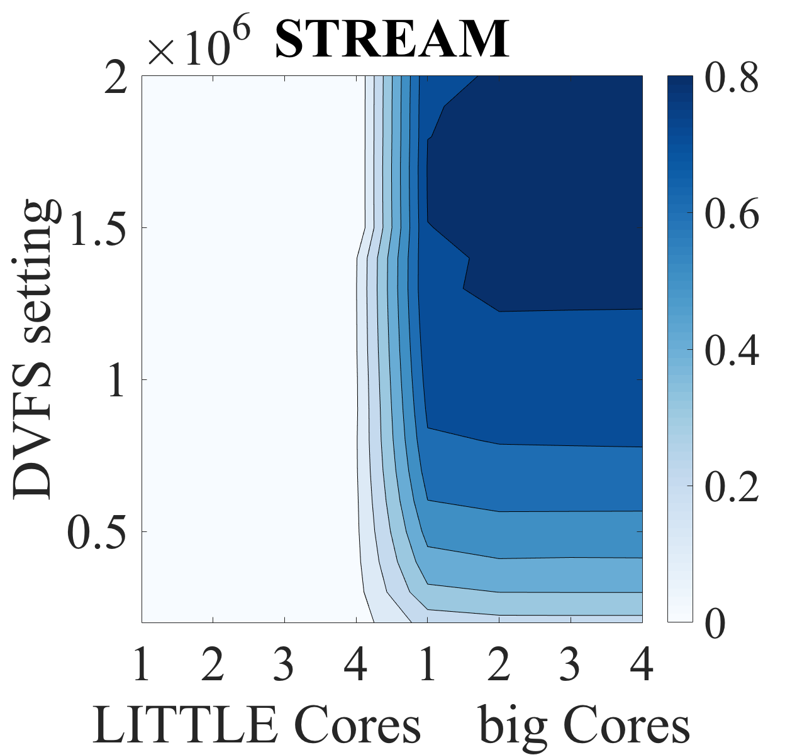

Slide 17
Control
Learning + Control

